Slide 1
Module 3:
Data Collection
Ethical Acquisition of Data from Human Subjects
ML for Cybersecurity

Slide 2
FAMOUS FAILURES

Slide 3
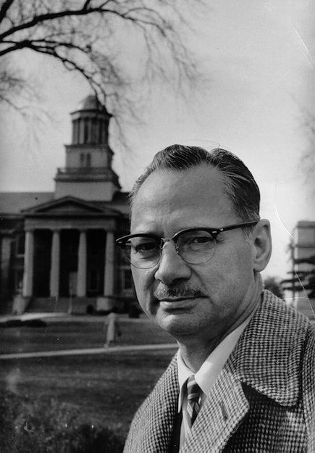
The Monster Study
University of Iowa, Wendell Johnson and Mary Tudor (1939)
Affirmation/criticism in speech therapy
Participants: 22 orphan children
Group 1: positive speech therapy / praise
Group 2: criticism for every imperfection
Children in the second group developed permanent speech issues

Slide 4
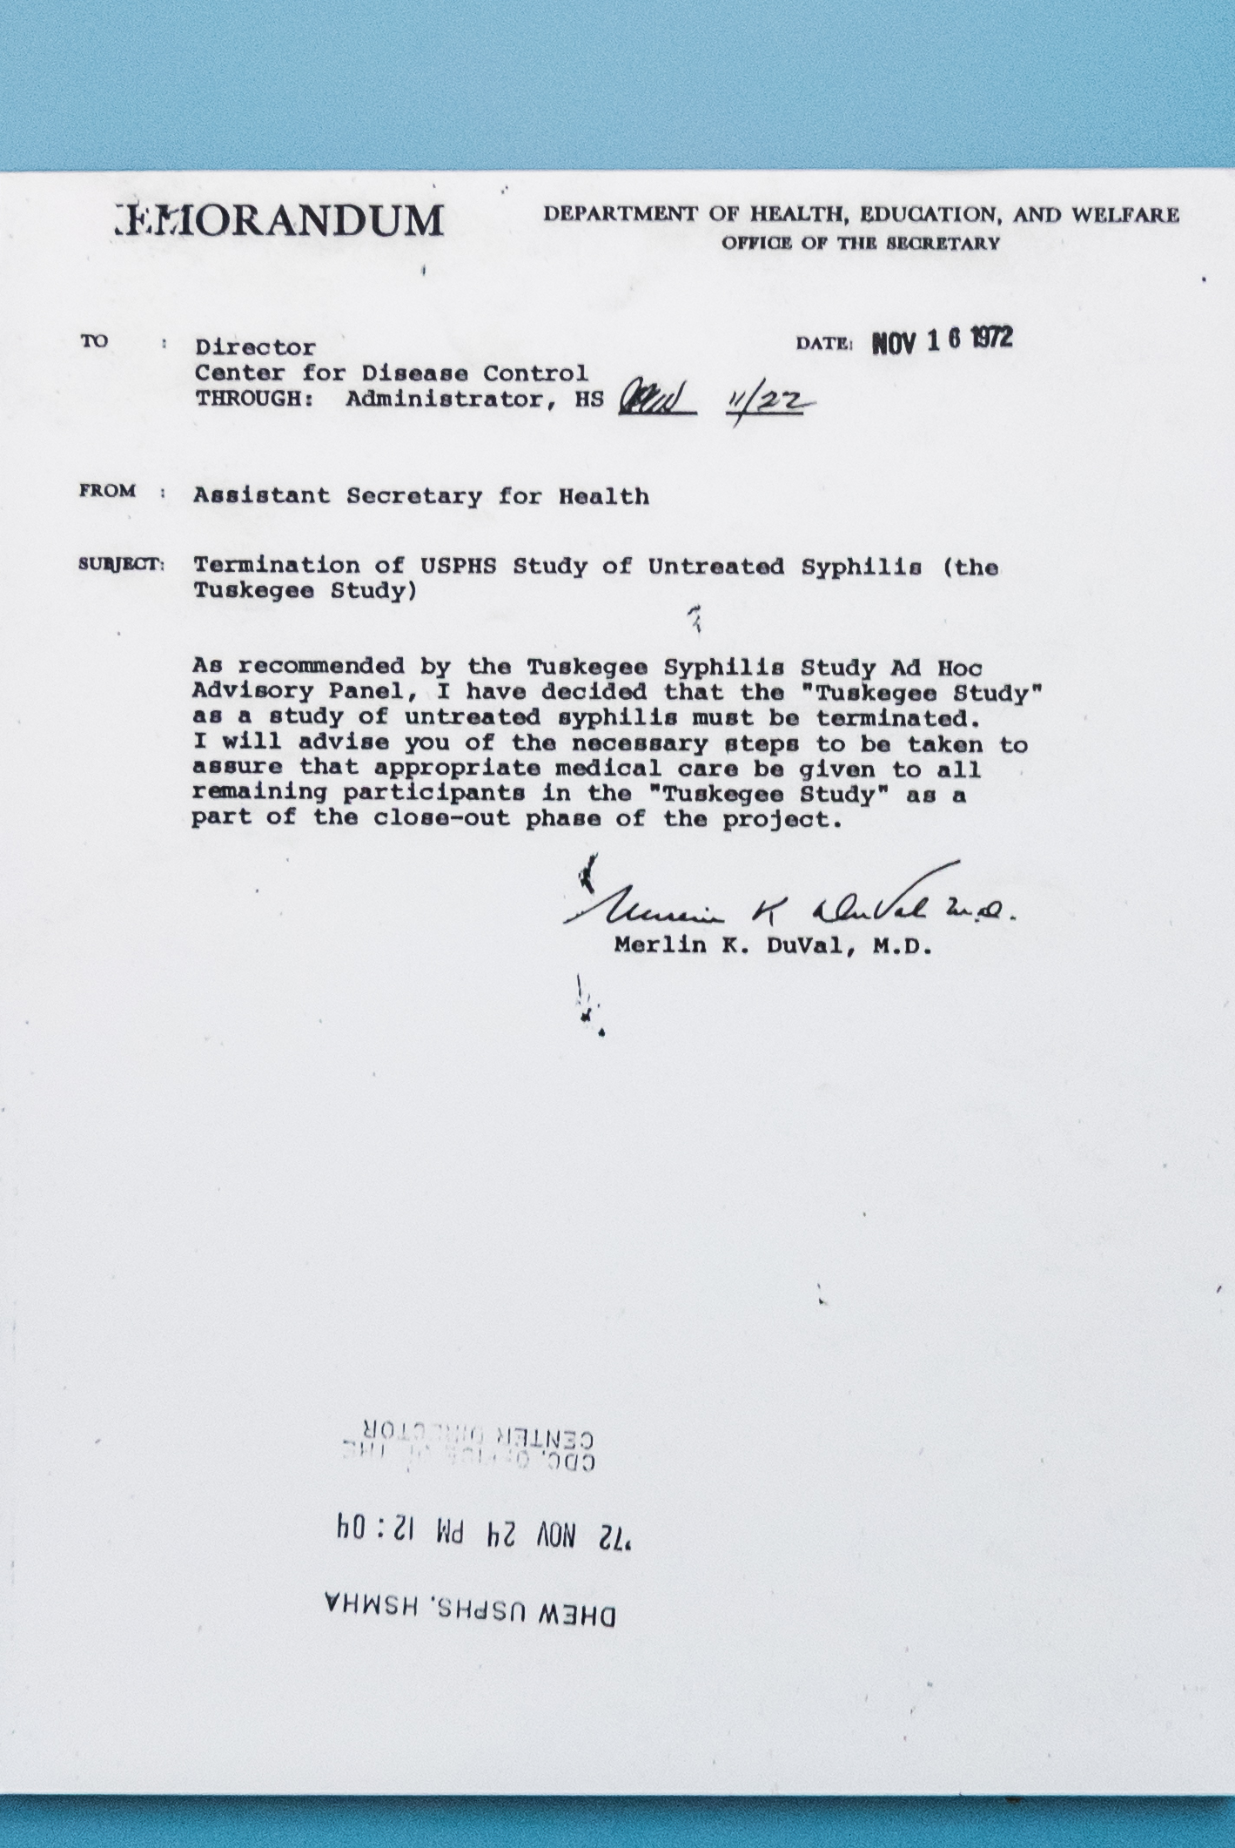
Tuskegee Syphilis Experiment
United States Public Health Service and Tuskegee University “Tuskegee Study of Untreated Syphilis in the Negro Male” 1932-1972
Participants: 600 impoverished, African American sharecroppers
399 with syphilis, 201 without (control group)
Not told they had syphilis
Not treated with penicillin

Slide 5

Emotional Contagion Study
Adam D. I. Kramer, Jamie E. Guillory, and Jeffrey T. Hancock. Experimental evidence of massive-scale emotional contagion through social networks. PNAS 111(24):8788-8790, June 17, 2014
A friend expressing emotion can impact the emotion of someone else
Participants: 689,003 Facebook users
Varied emotional expressions in News Feed

Slide 6
Human Subjects

Slide 7
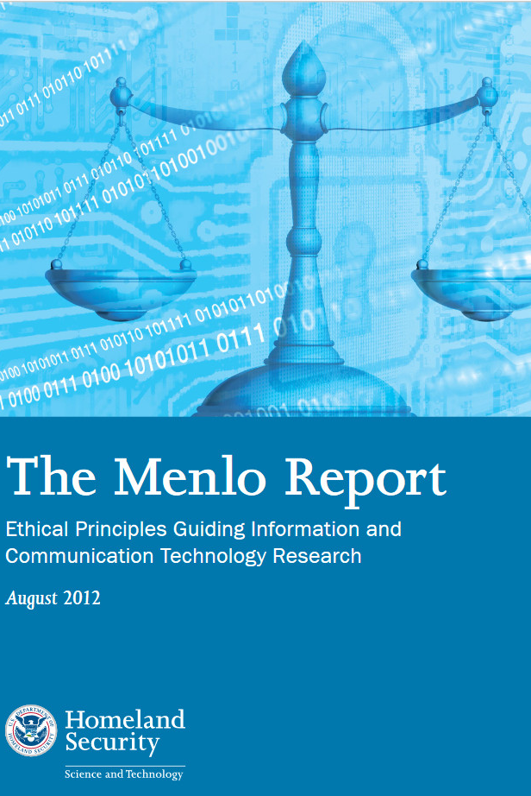
Protection of Human Subjects
Belmont Report (1978)
Respect for persons (informed consent)
Beneficence (maximize benefits vs. risks)
Justice (do not exploit / fair distribution)
Menlo Report (2012)
Respect for the law / public interest

Slide 8
Human-Subject Data for Cybersecurity ML
Do you need this data for your model?
How much do you actually need?
Do the data subjects know you are collecting this data?
Have they given meaningful, informed consent?
How, if at all, will the data subjects benefit?
How will society benefit?
What risks will the data subjects face from data collection / use?
Could a less invasive method provide equal insight?

